Slide 1
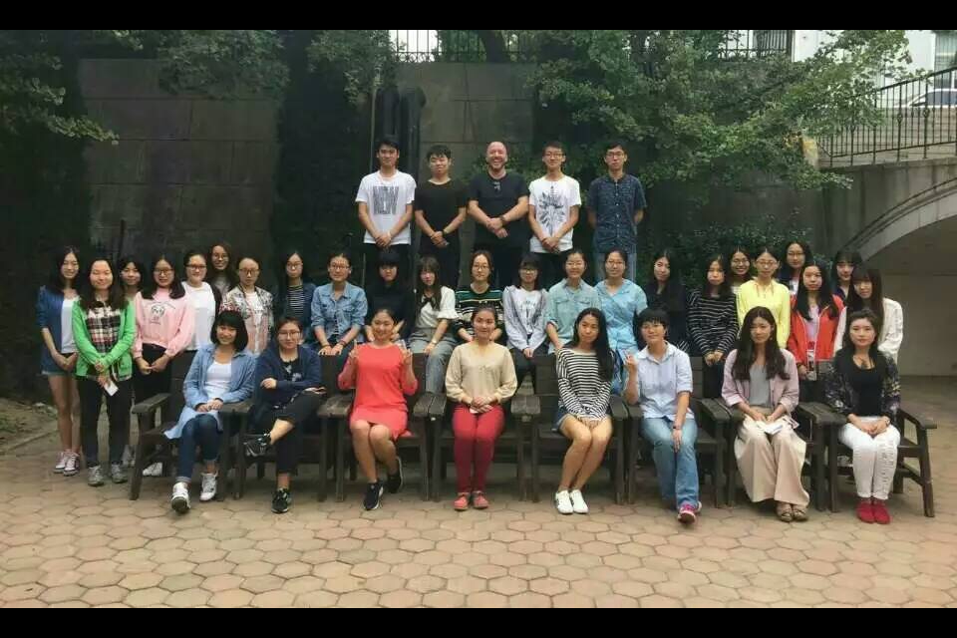
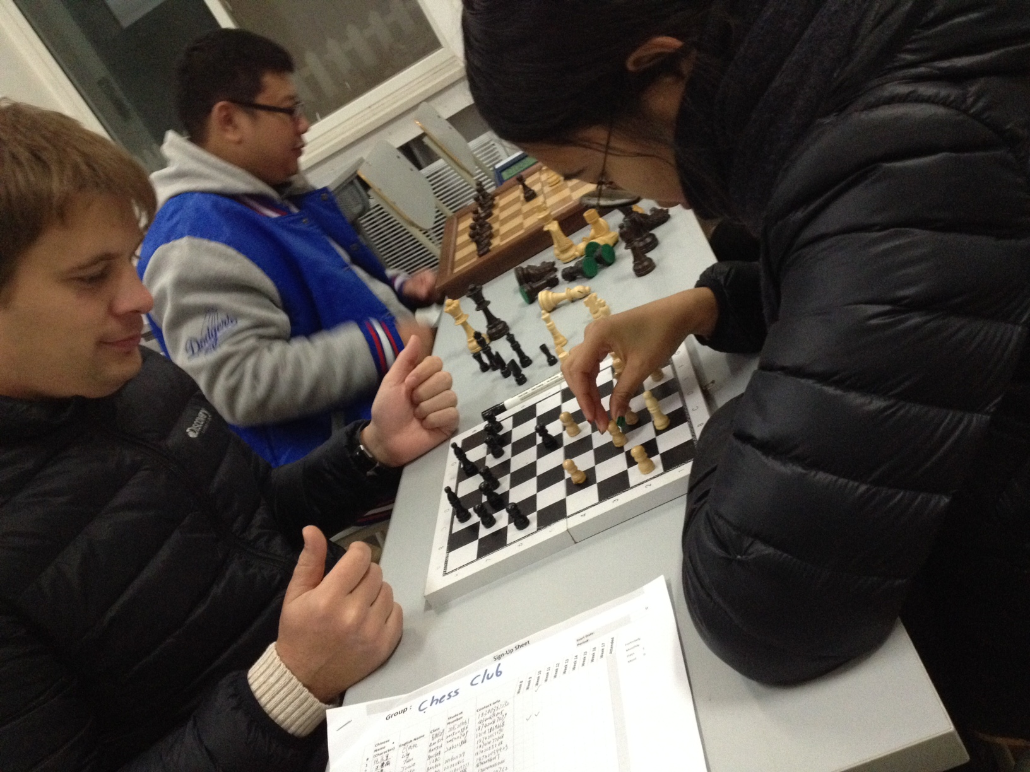
Student Support Activities: Writing Fellows

Slide 2
1.
Student Support Center
2.
Tutorials
Writing Fellows
Student
Support
Activities
Workshops
Student Interest Groups

Slide 3
Dramatic Growth in Need: Year 2014 vs. 2015
Student Support Center

Slide 4
Semester Change 2014 vs 2015
(Tutoring Sessions by week)

Slide 5
Too many students, Too few faculty Not enough writing help

Slide 6
New Program
]
Writing Fellows

Slide 7
Writing Fellows - Pilot
Select & Train 15 Talented 2nd and 3rd year students

Slide 8
TRAINING
1 Writing Process
2 Tutoring Techniques I
3 Tutoring Techniques II
4 Narrative Structure & Rubric
Mid-term
5 Feedback about Student Sessions
6 Understanding Teachers Fin Rubric
7. Feedback Conversation (Optional)
Each session is 1.5 hrs*

Slide 9
Fellows put in teams; Teams matched to teachers

Slide 10
Fellows matched to Students

Slide 11
Classroom View
Fellows
Students
Teacher

Slide 12
Fellow Sessions
Fellows read students’ papers prior to student conferences
Fellows meet each of their students for 40 minutes during the drafting process and provide verbal and Written feedback
Fellows hold students conferences twice: prior to midterms & prior to finals

Slide 13
Concerns
What is the quality of Peer Feedback? (Leki, 1990)
Students overwhelmingly prefer teacher Feedback (Zhang, 1995). Will students listen to Fellows?
Will Fellows respect the independence of unsupervised meetings?

Slide 14
Overheard in Observation

Slide 16
Student Surveys
90% of students met Fellows
91% of those agree the
Fellows were helpful
Offered over minimum 229 1-on-1 hours for students ( 1st semester)

Slide 17
Student Feedback
Fellows helped with hook, structure, task response, academic language
Fellows could explain assignments in Chinese
Students would like more time with fellows

Slide 18
Changes for Future
Mandatory Fellow-Teacher Meetings to align Fellow and teacher priorities when reading.
“Expectations of a Session” 1-page paper given to all Fellows & Students. (i.e. wechat sessions are forbidden, Fellows are expected to meet students only twice)
Application & Check list for faculty who want Fellows
Notes:
Voluntary Faculty Application for WF Program – This will help us fairly distribute fellows and make sure the teachers who are in the program are motivated
Student Intake Method – Teachers assign in-class writing on day one. Use this to select lowest 1/3 students of all classes. These students are given priority to sign-up with fellows. Fellows can then contribute more effectively.
12-14 students: Now that students are trained, instead of working with 8 students they can work with 12-14.

Slide 19
Writing Fellows
Provided 240 1-on-1 hours
of student support

Slide 20
WF Expansion in 2016-17
A Writing Fellows Program
Provides Peer Review
Develops Student Leaders
Increases learning away from the teacher/classroom
Provides a safe space for Lower-level language students to ask questions
Raises writing quality
Can be used across disciplines at undergraduate & graduate levels

