Slide 1
掀起“课堂革命”背景下EFL创新教学设计
郑州大学西亚斯国际学院
王静 张彩云 师坛

Slide 2
Contents
01
研 究 背 景
02
教学实践关键创新之处
03
学生受益情况
04
结 语

Slide 3
01
研 究 背 景

Slide 4
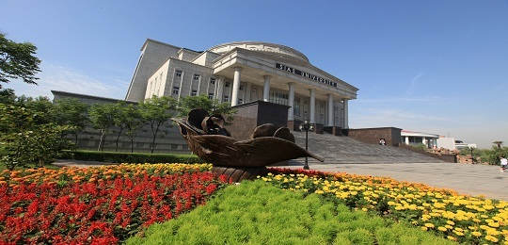
Dual Degree：
Sias International University
& Fort Hays State University

Slide 5
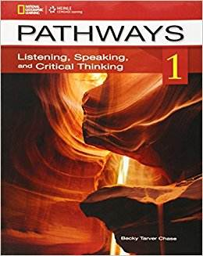
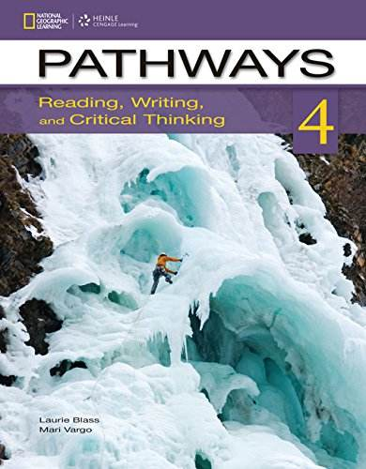
教材
Reading,
Writing
Listening
Speaking
Critical Thinking

Slide 6
02
教学实践关键创新之处

Slide 7
教学目的：
在掀起“课堂革命”背景下，EFL课堂通过创新性地设计课堂活动，鼓励学生主动参与，帮助学生提高英语沟通能力的同时，全面提高学生的人文素养和思辨能力。

Slide 8
创新教学设计有效框架
词汇
语法
创新教学设计
有效框架
篇章分析
写作训练

Slide 9
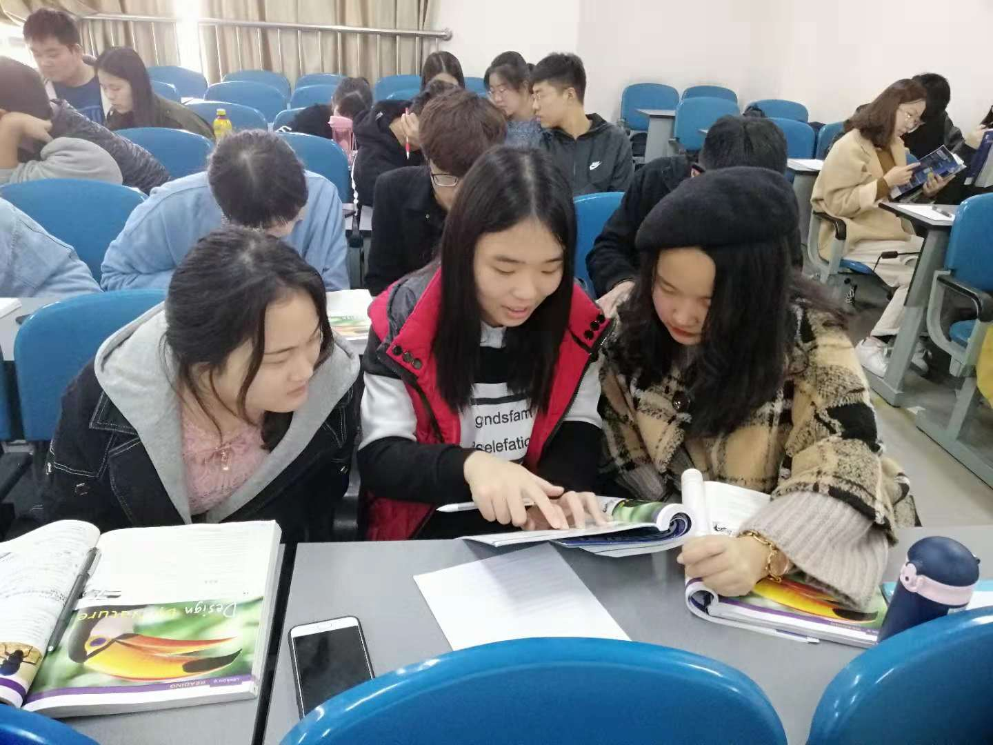
词汇
创新教学设计有效框架

Slide 10
语法
创新教学设计有效框架
（Jazz Chant）
Jessie Wants to Be Thin
-----By Shi Tan
Jessie loves to eat,
She always has chocolate,
She always has cake,
She always has twelve cans of tuna fish for dinner every night.
Her skirts are very tight,
She wants to be thin.
She could have fruit,
She could have milk,
She should give up chocolate,
She should give up cake,
She should give up 12 cans of tuna fish for dinner every night.
She should not have chocolate,
She should not have cake,
She should not have twelve cans of tuna fish for dinner every night.
If she wants to be thin.
She ought to obey the rules.

Slide 11
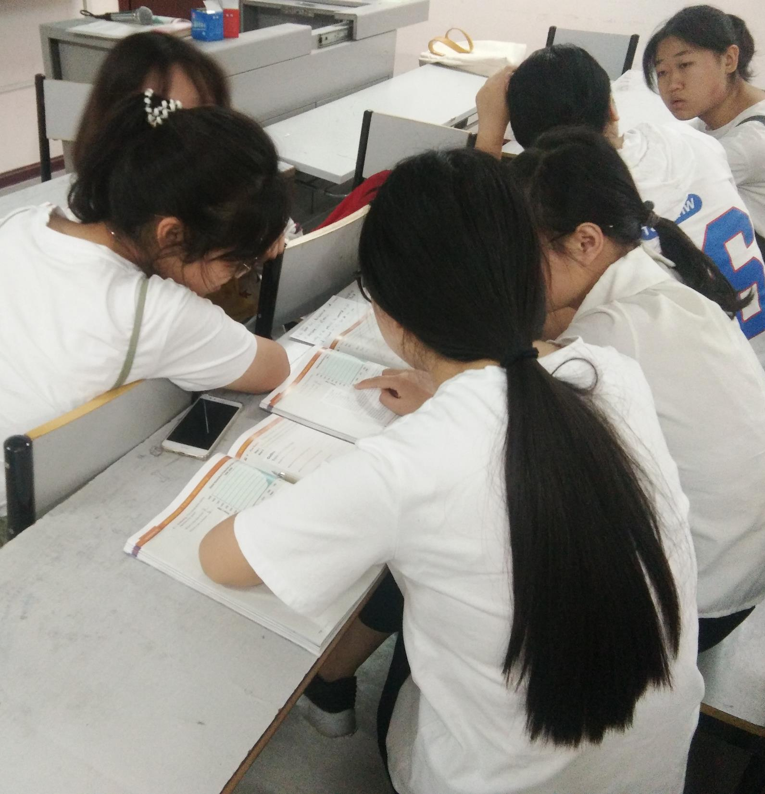
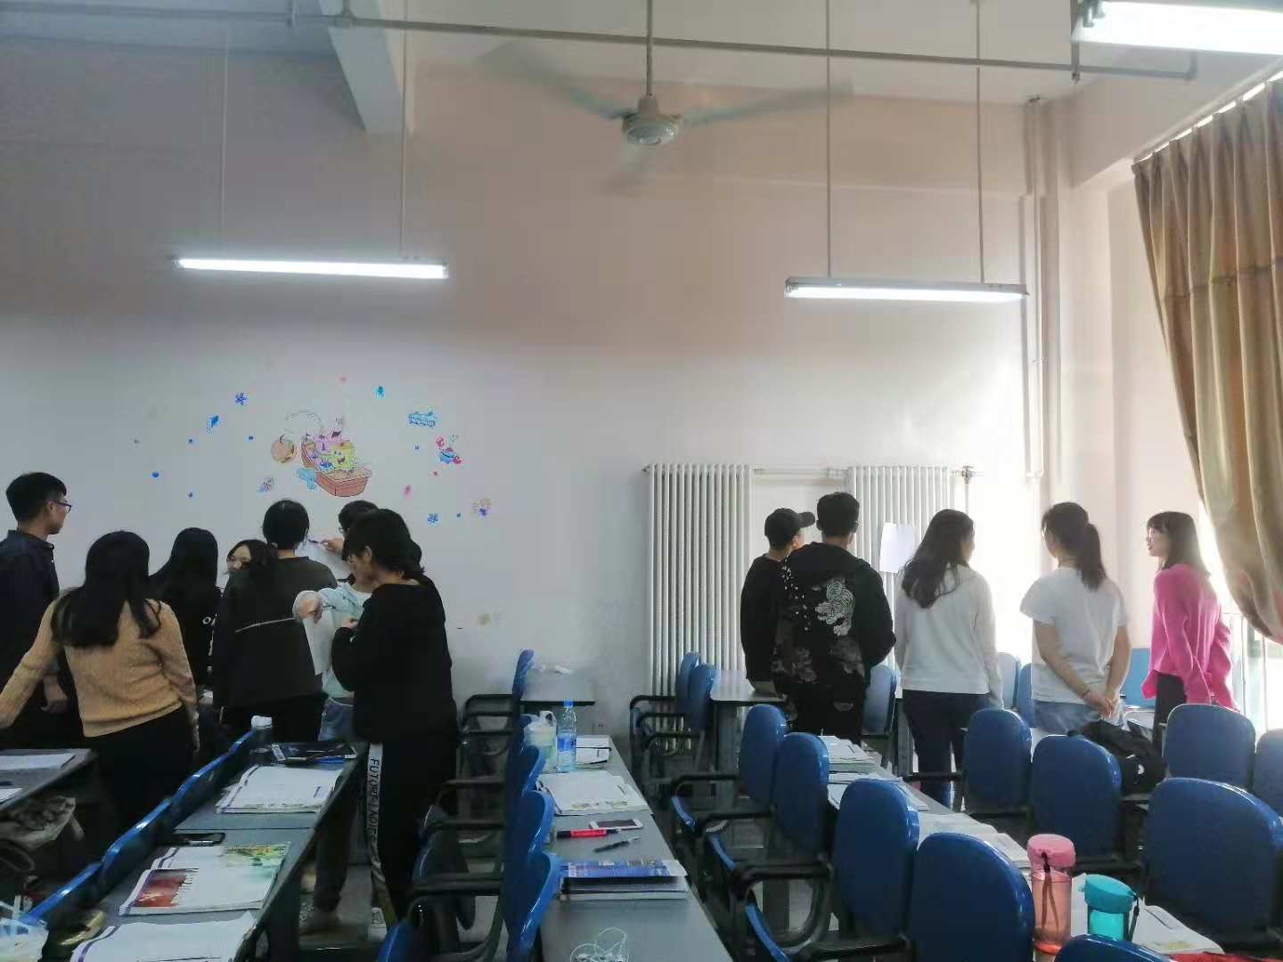
篇章分析
创新教学设计有效框架
Chat Station
Jigsaw

Slide 12
写作训练
Dialogue 2
Li Lei: I love you.
Han Meimei: Why?
Li Lei: I love you not because who you are, but because who I am when I am with you!
Han Meimei: When?
Li Lei: When I see a beautiful flower, I want to give it to you; When I go shopping, I want to buy you the most beautiful dress I see; When I watch a movie, visit a place, I can’t help thinking everything would be so perfect if you were there with me.
Dialogue 1
Jim Green: I love you.
Han Meimei: Why?
Jim: ...
Han Meimei: When?
Jim: ...
Details！

Slide 13
03
学生受益情况

Slide 14
学生受益情况

Slide 15
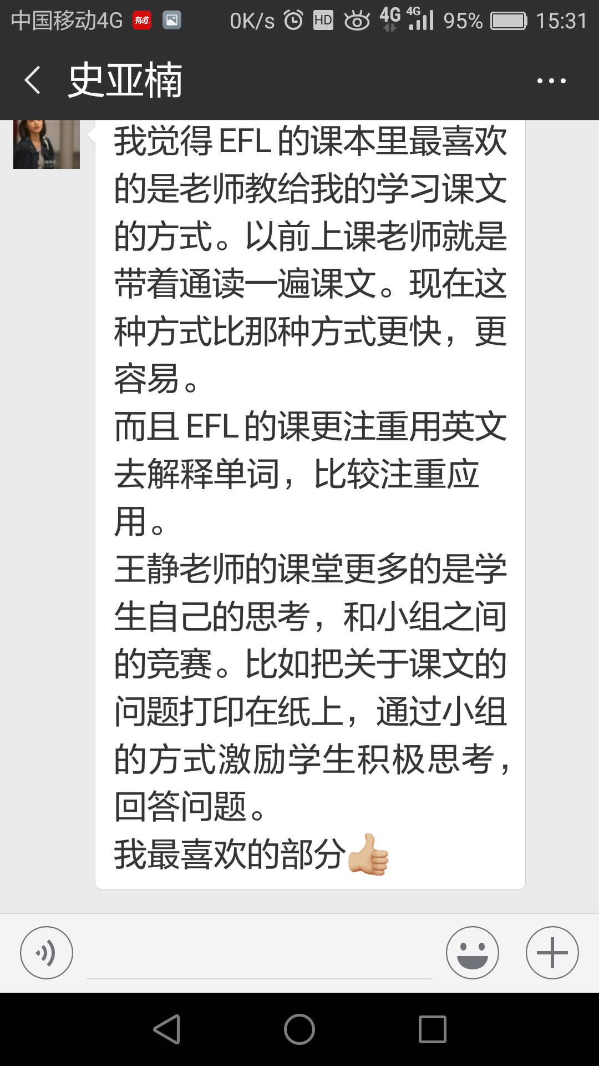
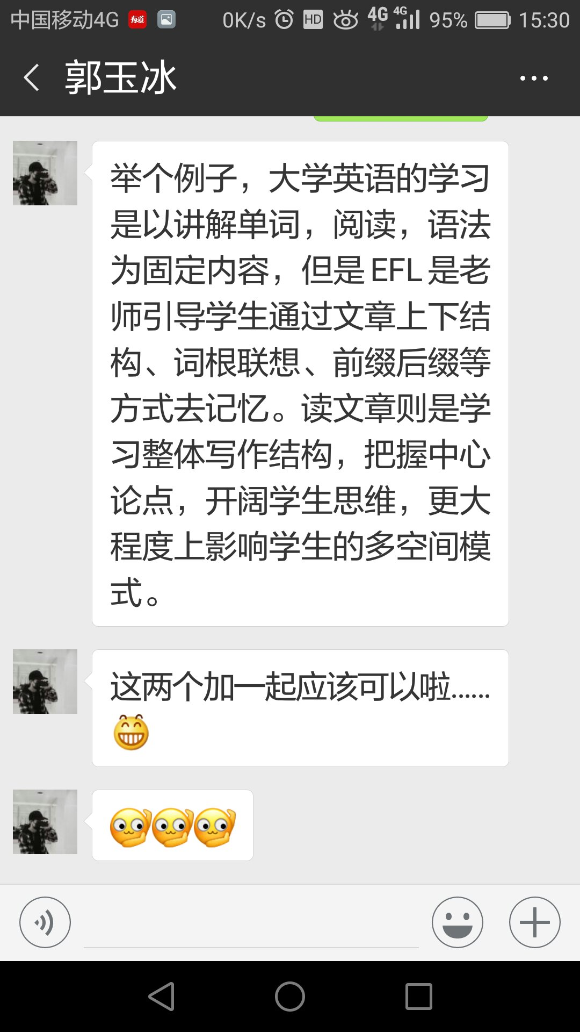
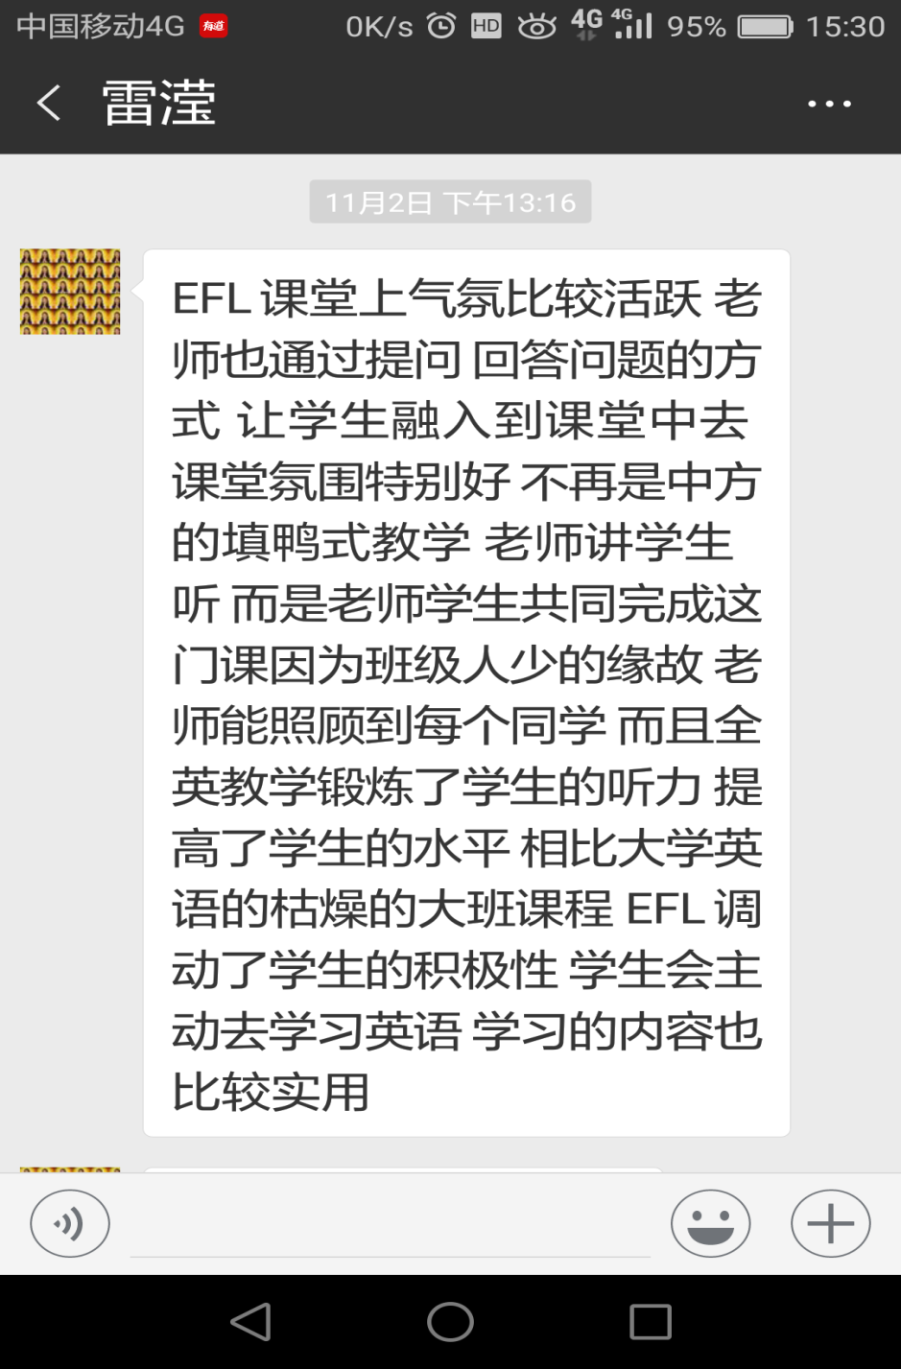
学生受益情况

Slide 16
04
结 语
结语：
培养创新人才是国家的重要人才培养战略。创新就是要改变传统的、一层不变的思维方式，鼓励勇于批判、大胆质疑的学习精神。大学生批判性思维能力的培养是高素质创新人才培养的关键，英语学习是培养批判性思维能力重要渠道之一，因此大学英语课堂的创新活动设计及实施显得尤为重要。我们的EFL课堂基于有效的教学创新设计来提高教学效果，充分响应教育部关于掀起“课堂革命”的号召，将传统单向的、沉默的课堂模式转变为多向的、活跃的、启迪学生智慧和培养学生实践能力的课堂。

Slide 17
Thanks for Watching
Notes:
更多精美PPT模板下载：
http://so.tukuppt.com/sousuo/15770370/

