Slide 2
Utilizing Poll Everywhere as an interactive active response tool to collect students’ immediate responses in a large classroom setting
Guhuai Jiang

Slide 3
Agenda
Challenges in teaching large undergraduate classes
Introduction of the functions of ‘Poll Everywhere’
Try ‘Poll Everywhere’ together
Advantages and disadvantages of ‘poll everywhere’
Some of the other active response systems and its comparisons

Slide 4
Challenges in teaching large undergraduate classes
What are some of the challenges in teaching large undergraduate classes?

Slide 5
Challenges in teaching large undergraduate classes
‘Large space- Large lectures take place in a big room, and interaction does not feel like personal communication because the instructor is so far away.
Isolation -Large lectures are full of people, mostly strangers, creating a sense for students that what they say and do doesn't matter.
Group size- The sheer number of students makes discussion during a regular lecture that includes everyone impossible’ (Gleason, 1986).

Slide 6
Challenges in teaching large undergraduate classes
‘One of the major challenges in teaching large undergraduate classes is engaging students and encouraging them to practice active learning. A number of new technologies have recently been developed to help facilitate this process. The most common technology now used in large classes is an audience response system. Audience response systems include any number of hand-held devices that allow students to respond and interact with the professor’ (Caldwell, 2007).

Slide 7
‘In a normal class discussion situation, only one or two students have the opportunity to answer a question... A student who is unsure of the correct answer may be unwilling to take the public risk of being incorrect. One of the best features of an SRS [student response system] is that it allows students to provide input without fear of public humiliation and without having to worry about more vocal students dominating the discussion’ (Martyn, 2007).

Slide 8
In-Class Audience Response System- Poll Everywhere
New technologies that universities can adopt to help facilitate better learning environments in large undergraduate classes generally fall into two categories:
those that enhance the in-class experience
those that create electronic tools and forums for students and teachers to use outside of class.
Poll Everywhere is one program that students can use on their mobile devices and respond immediately to questions asked by professors in class.

Slide 9
Poll everywhere

Slide 10
Notes:
These are the two poll activities I have used with my 2 classes of students recently-open ended questions.

Slide 11
https://www.polleverywhere.com/free_text_polls/jaia4UoH1ci6P4g
Notes:
You can see as soon as students started posting their thoughts the teacher’s screen projector are filled with students answers’/ comments on the big screen (personally I think it is more visible compared to padlet, as with padlet, teachers have to constantly move the small boxes on the screen and students’ phone screen sometimes can be too small to show/ accommodate all students’ answers. This poll everywhere function is quite handy as every participating student can see their answers automatically on the screen, which in a sense acknowledges their voice and in turn encourage more students to participate. –let’s have a look.

Slide 12
https://www.polleverywhere.com/free_text_polls/V3EJ5tKBFsC0cML
Notes:
You can also change the visual settings here from spotlight version (what we just saw) to text wall, or word cloud, or cluster version. You can also adjust the effect speed and some of the other following features. Let’s try.

Slide 13
https://www.polleverywhere.com/polls/jaia4UoH1ci6P4g/results
Notes:
Of course, you can view all students’ responses all at once with detailed information as to students’ screen names ( you can ask students to do it anonymously to encourage free speech or ask students to use their real names for attendance checking purposes-it really depends the purposes against which you are using for) and the time they posted as well as all the responses. Lets’ have a look.

Slide 14
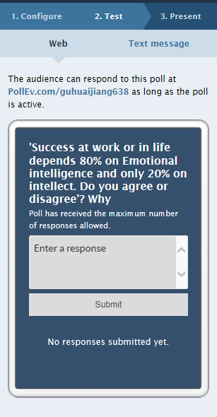
How can students respond?
Notes:
Usually we choose the way of the ‘website’.

Slide 15
Notes:
This class was on victim or creator mindset

Slide 16
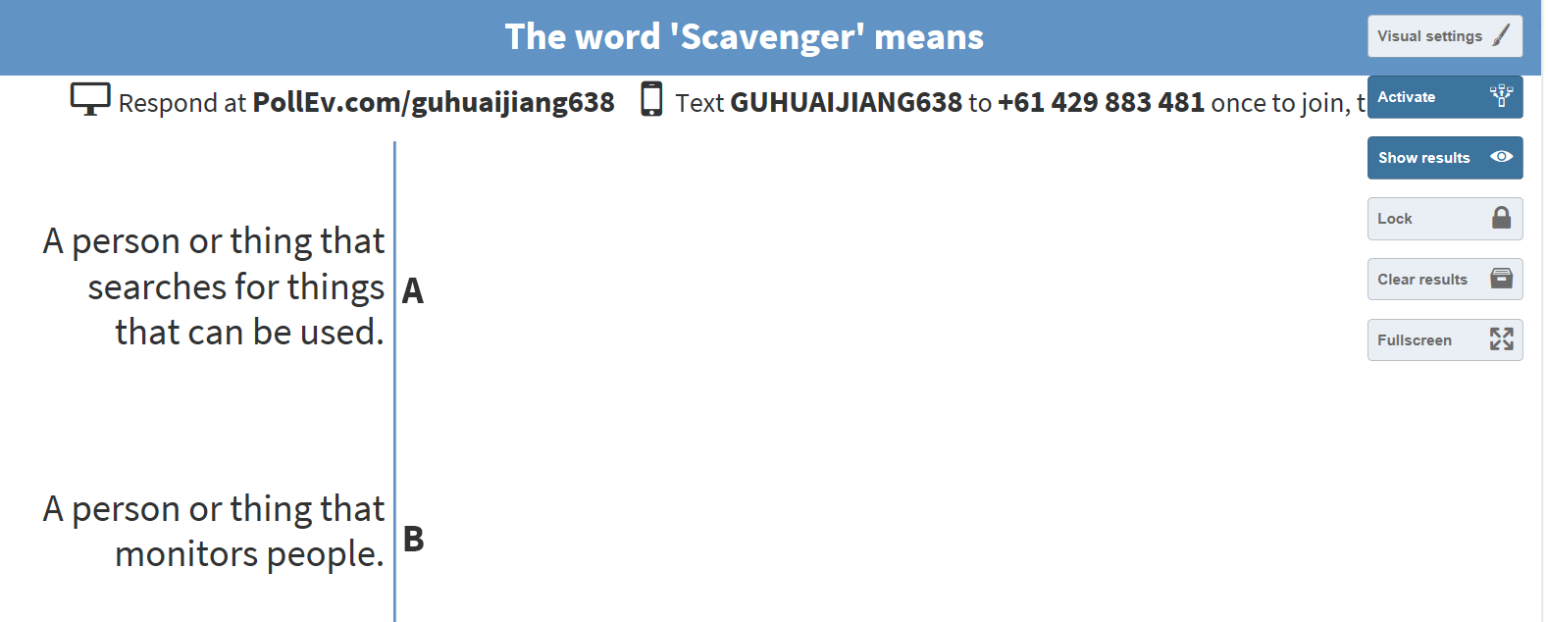
Let’s try it out together (3 question types)

Slide 17
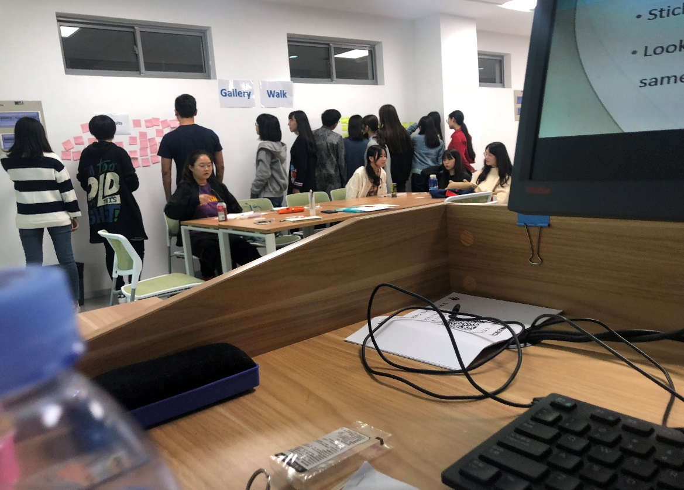
Discuss
How can you use Poll Everywhere in your class? Can you compare it with some other means to get student responses such as gallery walk (as shown below) or asking handing microphone to students in a big classroom?

Slide 18
Poll everywhere- Advantages
Allow students to contribute more freely than they could in a normal class discussion while remaining anonymous (students often use their nicknames).
Encourage active learning- everybody in a large class is encouraged to participate and allow students who might otherwise be nervous about participating.
Provide teachers with feedback on students’ progression in a course, allowing them to better address students’ needs and concerns.

Slide 19
Using Technology in Teaching Large Undergraduate Classes
Facilitate Class Discussion - Facilitate discussion by polling students’ opinions and discussing the reasons for their opinions.
Guide Lectures - Collect immediate feedback about students’ understanding of lecture topics so confusion can be addressed quickly.
Encourage Peer Instruction - Allow students to share, discuss, and exchange their opinions before answering a question.
Collect Data and Perform Formative Assessment - Collect data on course topics or learning preferences throughout the cycle of a course.
Take Attendance - Record attendance in large lecture courses.

Slide 20
References
Aagard, H., Bowen,K., and Olesova, L. 2010. “Hotseat: Opening the Backchannel in Large Lectures.”Educause Quarterly, 33: 3. http://www.educause.edu/EDUCAUSE+Quarterly/EDUCAUSEQuarterlyMagazineVolum/HotseatOpening theBackchannelin/213668
Caldwell, J. 2007. “Clickers in the Large Classroom: Current Research and Best-Practice Tips.” CBE Life Sciences Education, 6:1, 9-20. http://www.lifescied.org/cgi/content/full/6/1/9
Martyn, M. 2007. “Clickers in the Classroom: An Active Learning Approach.” EDUCAUSE Quarterly, 30:2. http://www.educause.edu/EDUCAUSE+Quarterly/EDUCAUSEQuarterlyMagazineVolum/ClickersintheClassroomAnActive/157458
Harlow, J. et al. 2008. “What’s all the clicking about? A study of Classroom Response System use at the University of Toronto.” http://faraday.physics.utoronto.ca/PVB/Harrison/Clickers/Clickers_PVB.pdf

