Slide 1
2018
第四届西浦全国大学教学创新大赛
樊袁利
西安文理学院

Slide 2
基于微课的大学英语视听说对分课堂教学模式实践
目录
CONTENTE
01
Introduction and Evaluation
02
Learning objectives
03
Students' presentation

Slide 3
Introduction
LOGO 输入标题内容
复旦大学张学新教授认为“对分课堂结合了传统课堂和讨论式课堂的优势。它的核心理念是把一半课堂时间分配给教师进行讲授，另一半分配给学生以讨论的形式进行交互式学习。类似传统课堂，对分课堂强调先教后学，教师讲授在先，学生学习在后。类似讨论式课堂，对分课堂强调生生、师生互动，鼓励自主性学习。对分课堂的关键创新在于把讲授和讨论时间错开，让学生在课后有一周时间自主安排学习，进行个性化的内化吸收。对分课堂把教学分为在时间上清晰分离的三个过程，分别为讲授(Presentation)、内化吸收(Assimilation)和讨论(Discussion)，因此对分课堂也可简称为PAID课堂。换言之，这种模式就是把教师讲授和学生讨论在时间上错开，让学生在课后能有一周左右的时间自主安排学习，对课堂讲授内容因人而异进行内化吸收，然后进行有准备的讨论。

Slide 4
Introduction
LOGO 输入标题内容
基于微课的大学英语视听说对分课堂教学模式实践研究,就是用微课来代替教师的课堂讲授环节，在上课的前一周教师把要学习的重点难点用微课的形式发给学生，在相对宏观的层面上，告诉学生学什么、为何学和如何学。对分课堂讲授的核心目标是促进学生随后的学习，这是教师是学生学习的引导者和促进者理念的一个集中体现。我们进行的是隔堂对分，学生课后有一周的时间学习，因此布置有深度作业。作业目的是引导、督促课后复习，保证理解基本内容，为深入、有意义的小组交流讨论做铺垫和准备。小组讨论通常4人一组，时间为5-20分钟。要求学生围绕作业，先向其它三个组员解释一下自己的亮闪闪是什么，为什么自己觉得这个点最精彩，都讲完后，可以评选出小组的亮闪闪，随后向全班交流。学生可以把自己的考考你问题抛出来，请别的学生解答，看他们是不是能解释清楚，也可以把自己的帮帮我问题提出来，向别的学生请教。教师总结部分，主要责任是解答大多数同学的共性问题。对学生提出的问题，教师要甄别、选择，只处理共性问题以保障课堂效率和教学质量。

Slide 5
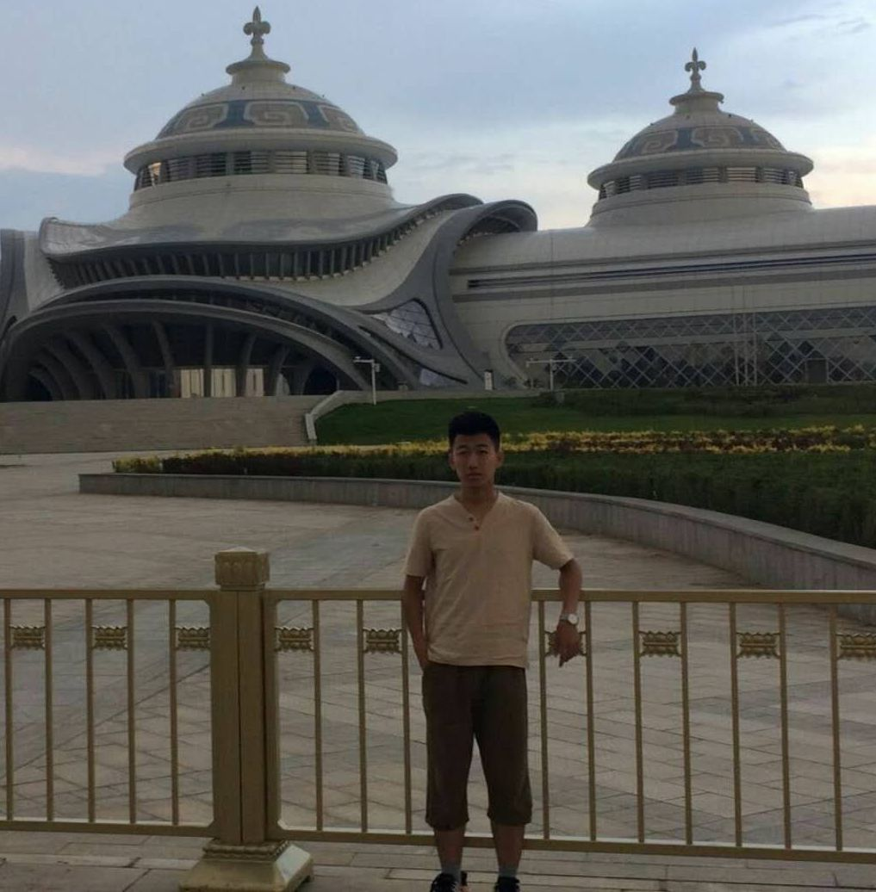
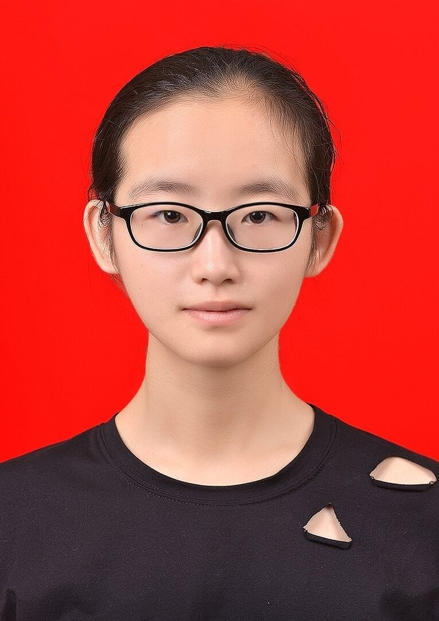
Evaluation
LOGO 输入标题内容
通过一个学期的实践，大多数学生对“对分课堂”的学习模式持肯定态度，认为这种新模式增强了他们学习的主动性。对分课堂这种新模式的应用，使得学生在课堂上的角色从单纯的接受者转变成了知识的创造者，还锻炼了与人交流的能力。
学生在微课堂上获得了知识的框架，理解了重点和难点，明确了教师布置的作业，微课堂后一周的学习时间和学习强度由学生自主安排，培养了他们学习的自主性有助于他们对知识的内化吸收，提高了学生学习的信心和兴趣。

Slide 6
Learning objectives
Listening skills
Identify words and expressions for describing people’s appearance

Slide 7
Listening skills
LOGO 输入标题内容
People’s appearance | Expressions
Face | round, oval, square, with wrinkles / freckles, pale
Clothes | casual, tidy, messy, shabby, stylish, old-fashioned, fashionable
Facial expression | happy, excited, sad, tired, upset, curious, dark, thoughtful, worried
Manners | graceful, polite, elegant, well-mannered, ill-mannered
Personality | bad-tempered, friendly, easy-going, introverted, extroverted, shy, cruel,mean, open-minded, outgoing, good-tempered
Intelligence | intelligent, bright, clever, dumb, stupid, smart, wise
General appearance | pretty,cute,handsome,plain-looking,beautiful
Build(the size of shape) | tall,short,overweight,underweight,fat,robust,thin,skinny,slim,slender
Hair or beard | long/short hair,curly/straight/wavy hair,bald,grey/white beard
Eyes | blue/brown eyes,round/almond-shaped eyes,big/small eyes
Age | little,teenager,young,old,middle-ages,elderly,in his/her (early/late)20s

Slide 8
Students' presentation
 | OK
I can describe people's apperance in English.
I can identify words and expressions for describing people’s appearance in listening.
√
√

Slide 9
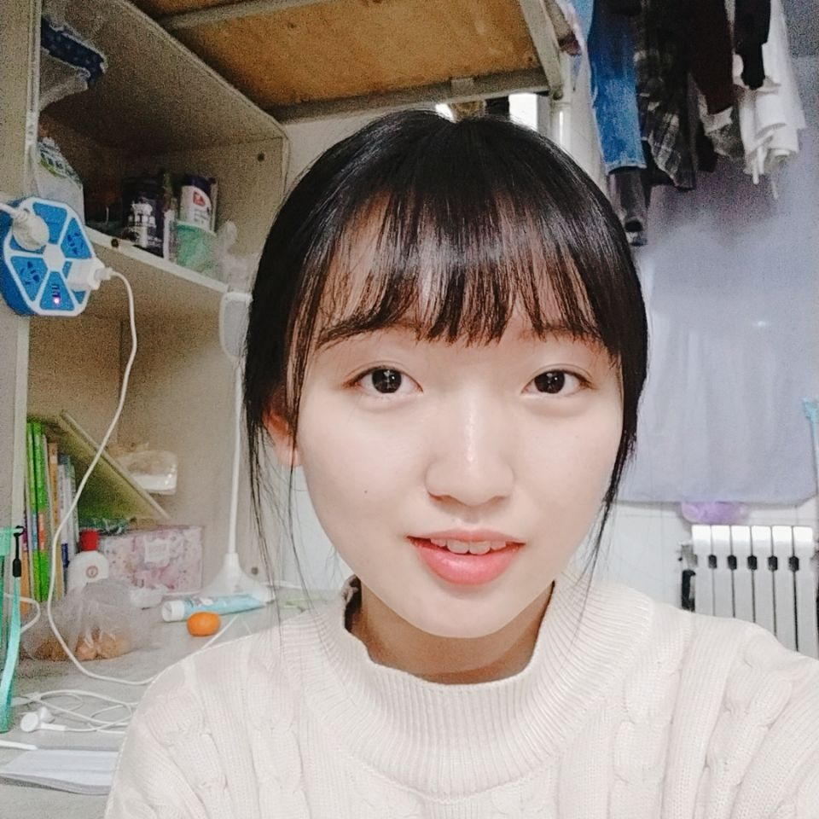
亮闪闪
LOGO 输入标题内容
My mother is an easy-going middle-ages person.She has big eyes and brown curly long hair.I think she has perfect tall and she is a little fat.My father is a little fat,too.He has black straight short hair.He is bigger than my mother and he is really intelligent.They have some things I am not happy,but I love them.Because they are excellent people.

Slide 10
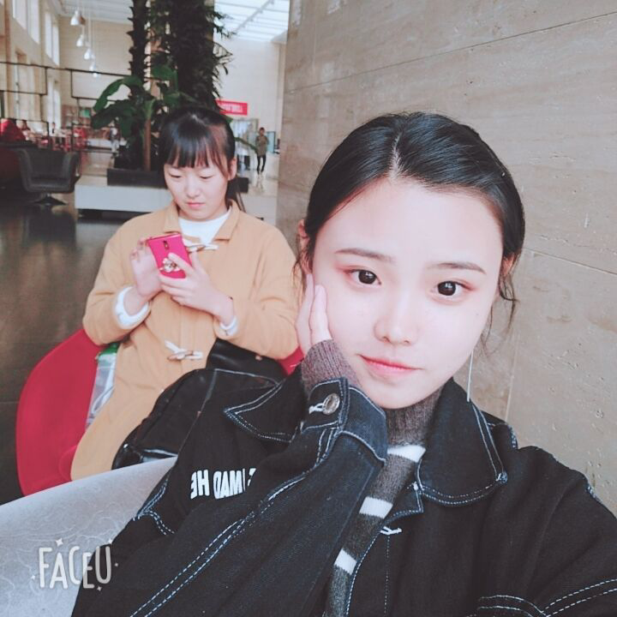
亮闪闪
LOGO 输入标题内容
My best friend has a smooth oval face ,her name is Ying .She has a pair of brown eyes and short black hair .She is older than me and i am taller than her .Most of the time ,she wears casual clothes and keeps an optimistic state of mind . Since the childhood ,She is so smart that can study in Beijing .This is one of the reason why I admire her.

Slide 11
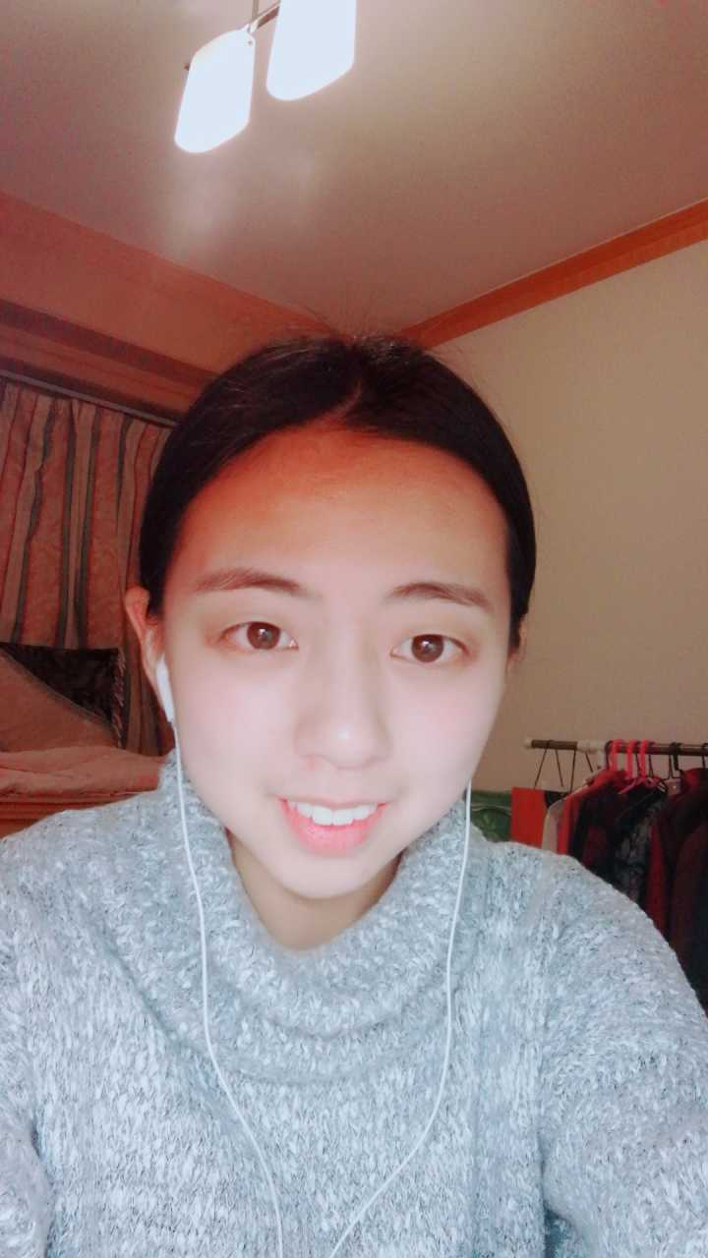
亮闪闪
LOGO 输入标题内容
My friend is an easy-going girl.She is very beautiful and cute.Her eyes are black.Her hair is long and straight.She is tall and thin.But she eats too much these days ,so her face is getting round.She looks very graceful and polite ,because clothes are very tidy.She usually has a warm smile on her face.She is very happy.I love my friend.

Slide 12
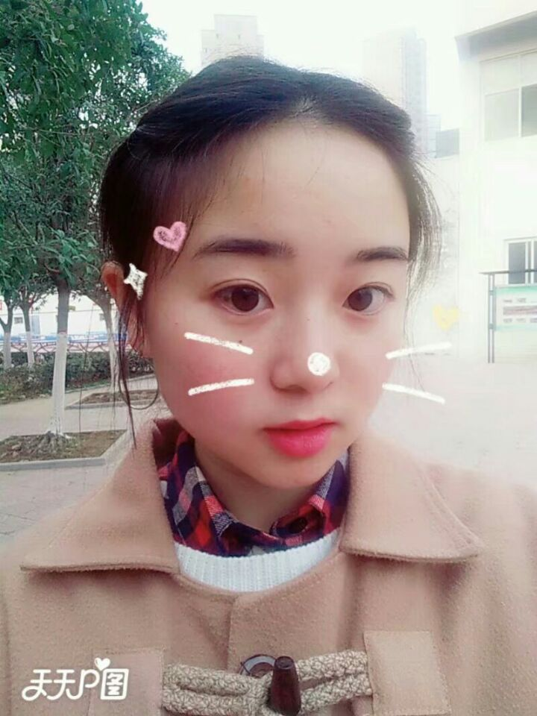
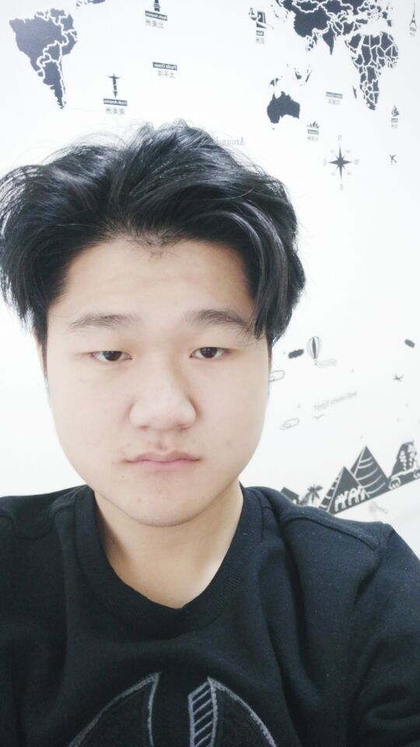
考考你
LOGO 输入标题内容
Mammy emerged from the hall,a huge old woman with the small, shrewd eyes of an elephant. She was shining black,pure African,devoted to her last drop of blood to the O’Haras’ Ellen’s mainstay, the despair of her three daughters, the terror of the other house servant.
a huge old woman ,small, shrewd eyes of an elephant, shining black,pure African

Slide 13
考考你
LOGO 输入标题内容
He was sixty years old and his crisp curly hair was silver-white,but his shrewd face was unlined and his hard little blue eyes were young with the unworried youthfulness of one who has never taxed his brain with problems more abstract than how many cards to draw in a poker game.he was as Irish a face as could be found in the length and breadth of the homeland he had lefted so long ago---round, high-coloured, short-nosed,wide-mouthed and belligerent.
He was sixty years old ,curly hair was silver-white, his hard little blue eyes,Irish face ,round, high-coloured, short-nosed,wide-mouthed and belligerent

Slide 14
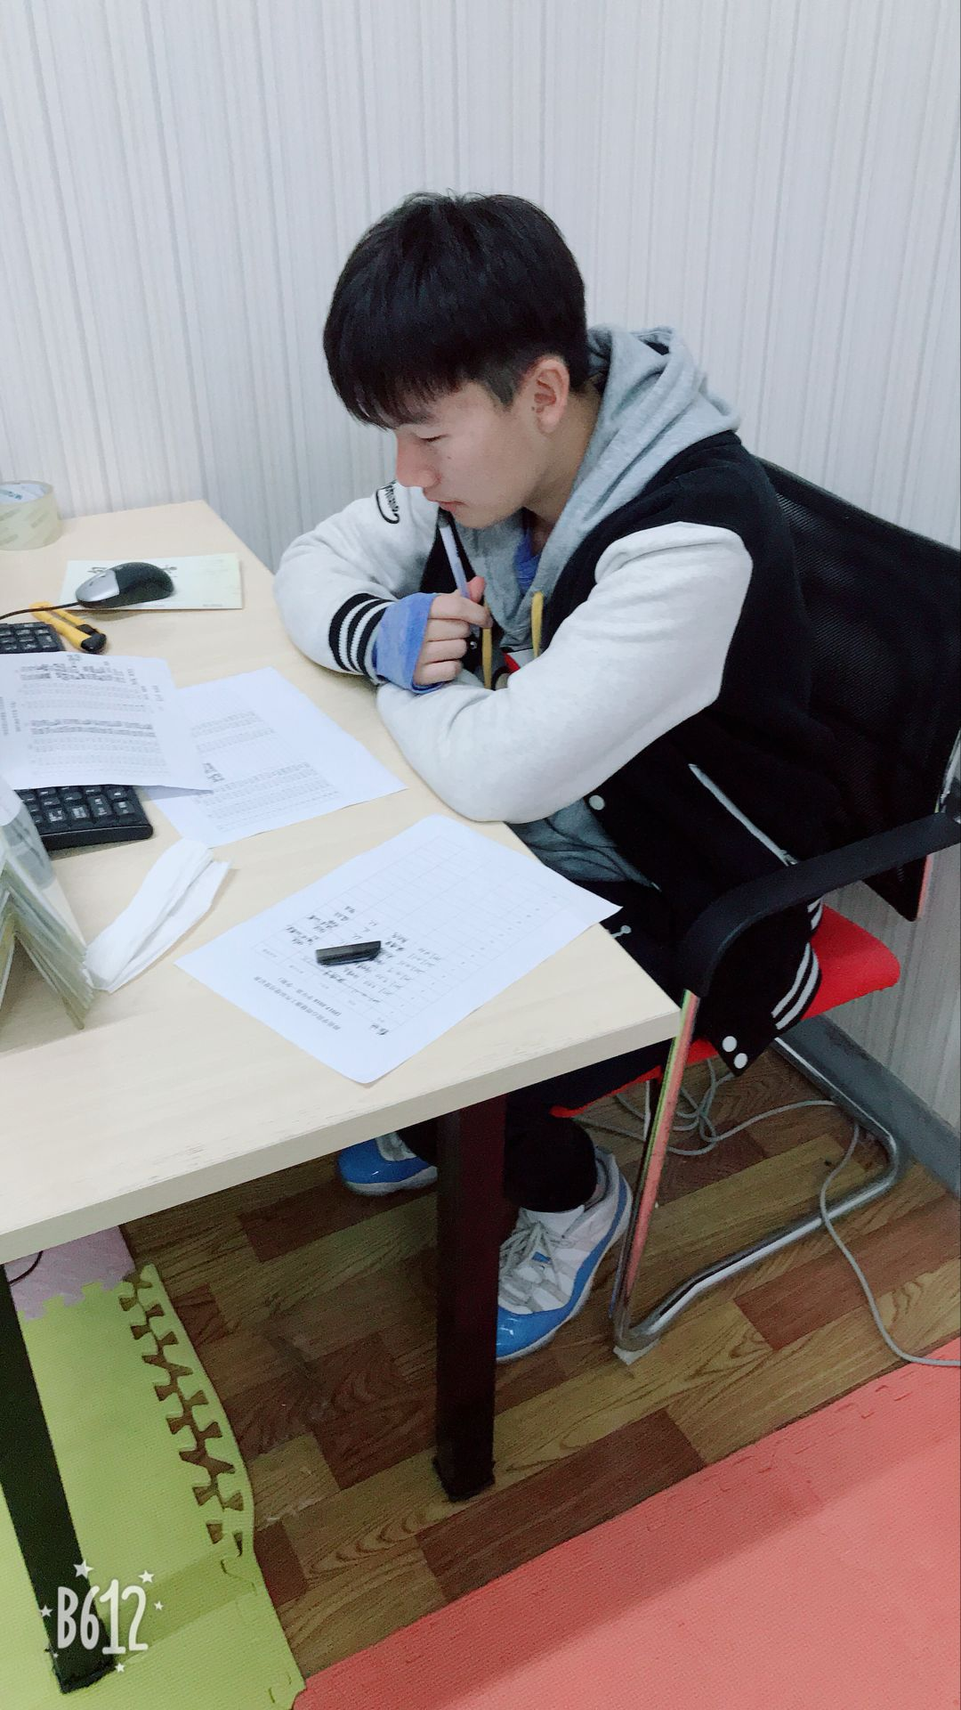
考考你
LOGO 输入标题内容
He looked quite old, at least thirty-five.he was a tall man and powerfully built. Scarlett thought he had never seen a man with such wide shoulders, so heavy with muscles,almost too heavy for gentility. When her eyes caught his,he smiled ,showing animal-white teeth below a close-clipped black moustache. He was dark of face,swarthy as a pirate,and his eyes were as bold and black as any pirate's appraising a galleon to be scuttled or a maiden to be ravished. He didn't know who he could be, but there was undeniably a look of good blood in his dark face. It showed in the thin hawk nose over the full red lips, the high forehead and the wide-set eyes.
old,thirty-five,tall,powerfully built, wide shoulders,heavy with muscles,animal-white teeth,close-clipped black moustache,dark face,bold and black eyes, thin hawk nose,full red lips, the high forehead and the wide-set eyes

Slide 15
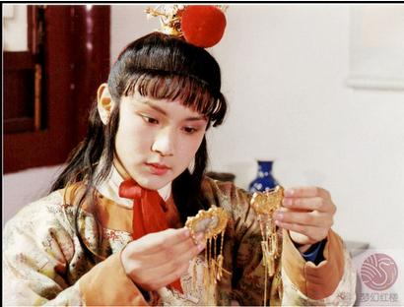
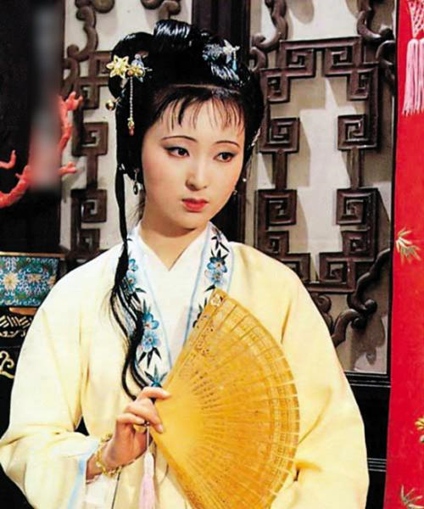
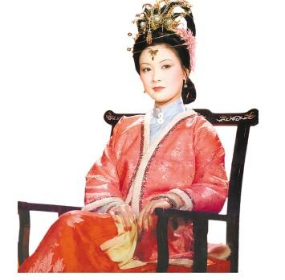
考考你
LOGO 输入标题内容
Her two arched eyebrows, thick as clustered smoke, bore a certain not very pronounced frowning wrinkle. She had a pair of eyes, which possessed a cheerful, and yet one would say, a sad expression, overflowing with sentiment. Her face showed the prints of sorrow stamped on her two dimpled cheeks. She was beautiful, but her whole frame was the prey of a hereditary disease. The tears in her eyes glistened like small specks. Her balmy breath was so gentle. She was as demure as a lovely flower reflected in the water. Her gait resembled a frail willow, agitated by the wind. Her heart, compared with that of Pi Kan, had one more aperture of intelligence; while her ailment exceeded (in intensity) by three degrees the ailment of Hsi-Tzu.

Slide 16
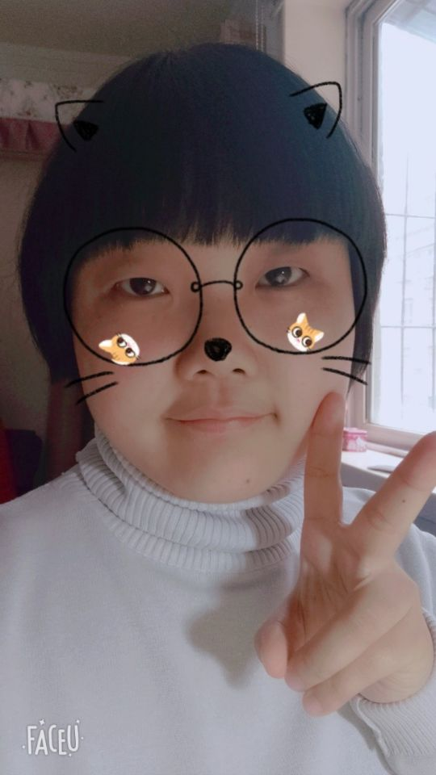
帮帮我
LOGO 输入标题内容

Slide 17
2018
PPT模板下载：www.1ppt.com/moban/ 行业PPT模板：www.1ppt.com/hangye/
节日PPT模板：www.1ppt.com/jieri/ PPT素材下载：www.1ppt.com/sucai/
PPT背景图片：www.1ppt.com/beijing/ PPT图表下载：www.1ppt.com/tubiao/
优秀PPT下载：www.1ppt.com/xiazai/ PPT教程： www.1ppt.com/powerpoint/
Word教程： www.1ppt.com/word/ Excel教程：www.1ppt.com/excel/
资料下载：www.1ppt.com/ziliao/ PPT课件下载：www.1ppt.com/kejian/
范文下载：www.1ppt.com/fanwen/ 试卷下载：www.1ppt.com/shiti/
教案下载：www.1ppt.com/jiaoan/ PPT论坛：www.1ppt.cn
Thanks for your attention!

